Slide 1


Value of Collaboration between NYSDOL and State University of New York to support Registered Apprenticeship
May 18, 2023

Slide 2
“
SUNY has provided life changing educational opportunities for countless students and we must continue to provide the resources needed for the next generation of students seeking a world class education. Governor Kathy Hochul

Slide 3
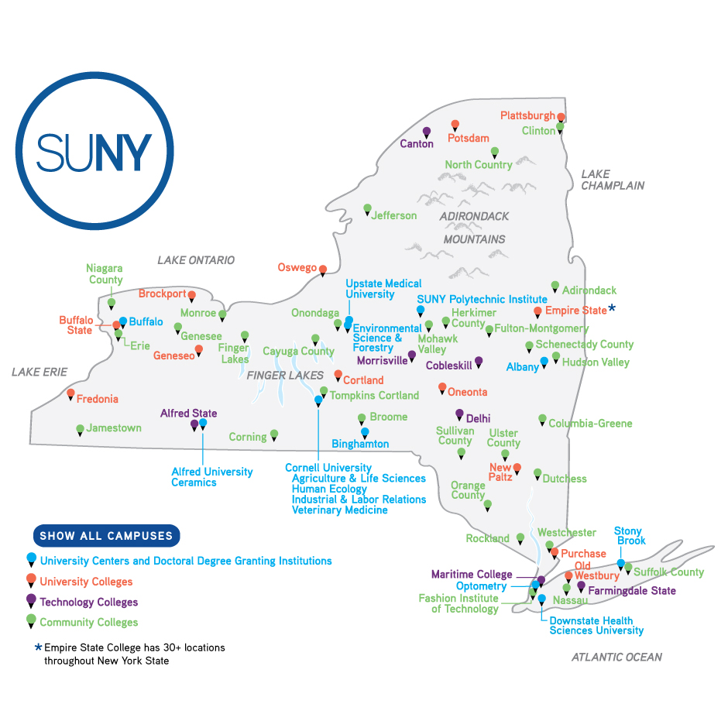
What is SUNY?
64 institutions
Research universities, academic medical centers, liberal arts colleges, community colleges, colleges of technology & an online learning network
Serving nearly
1.3 million students
Nearly 600,000 in credit bearing courses/programs & 700,000+ through continuing education & community outreach programs

Slide 4

Workforce development training customized for employers to upskill their workforce
Apprenticeship activities in partnership with business, NYS Department of Labor (NYSDOL) and US Department of Labor in advanced manufacturing, healthcare, etc.
Training for individuals impacted by COVID pandemic in partnership with NYSDOL under US Department of Education’s Reimagine Workforce Preparation grant
Program development through Future of Work Centers to address regional workforce demands
SUNY Statewide Workforce Programs

Slide 5
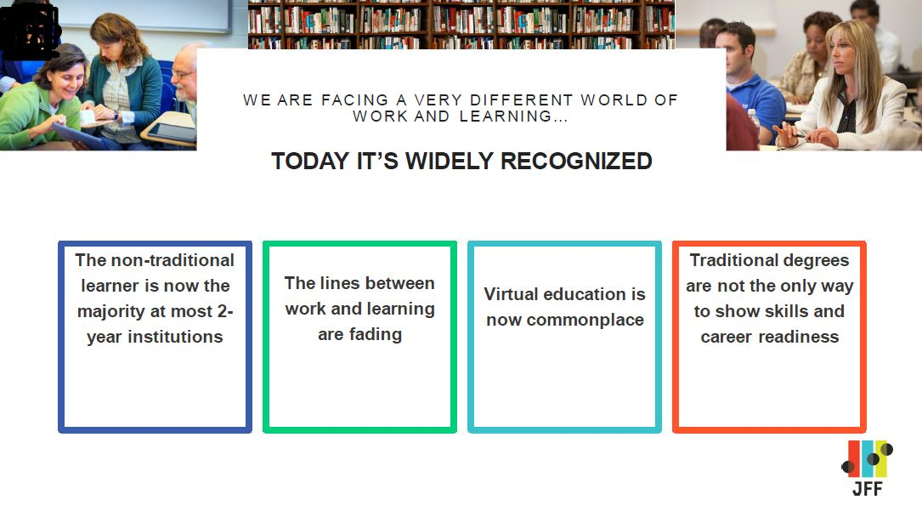
SUNY’s students today look like:

Slide 6
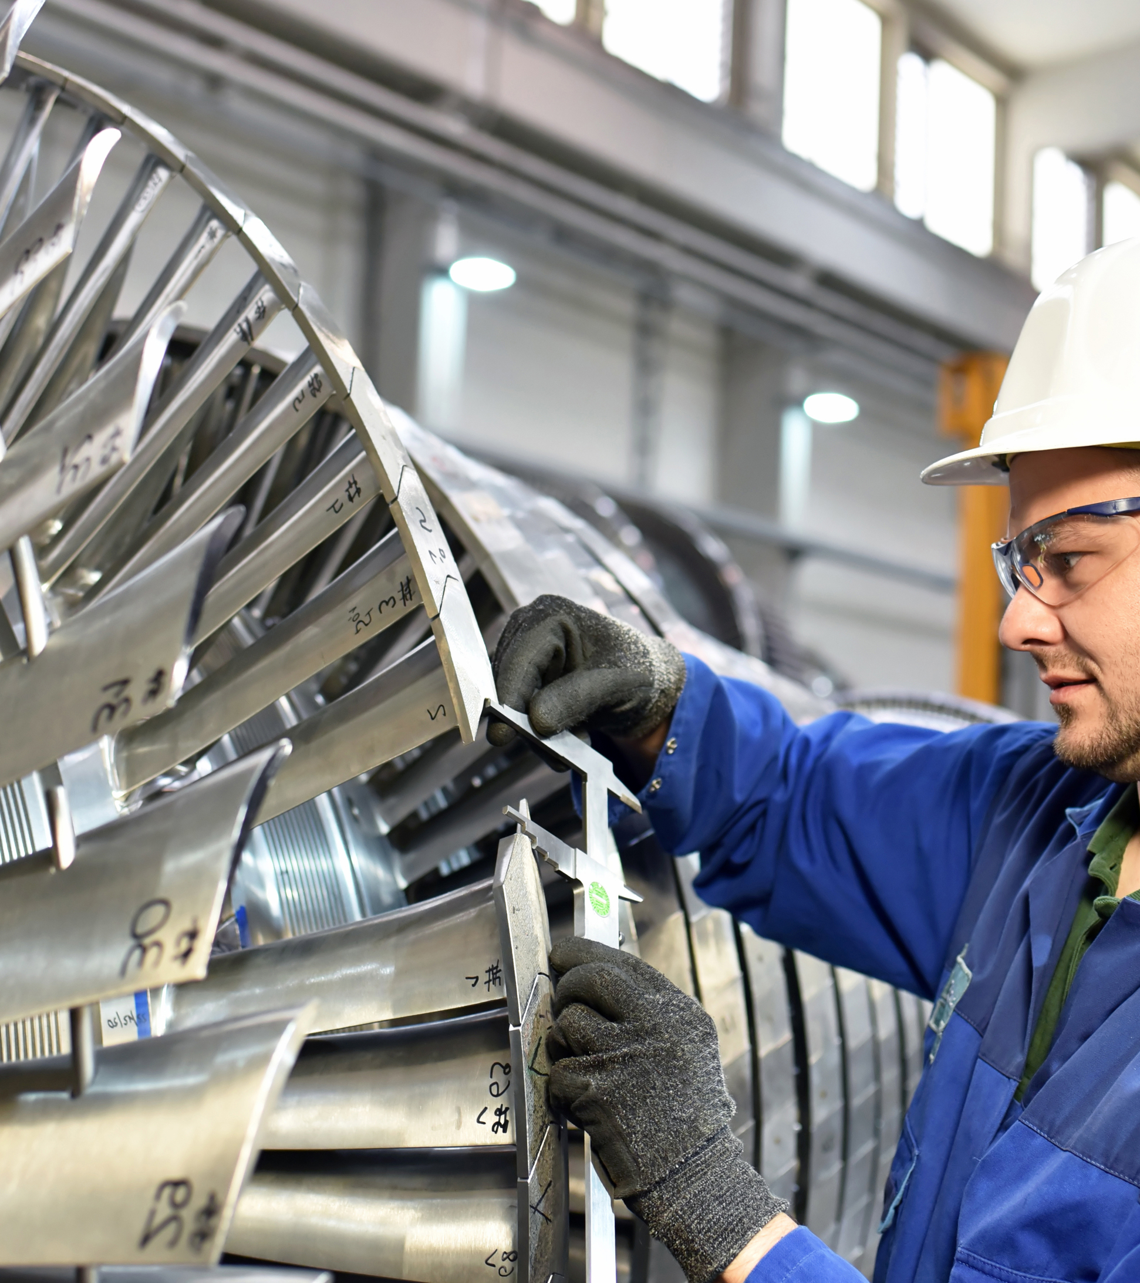
Apprentices at SUNY
Have been away from classroom for extended period
Are non-matriculated (have not declared a degree bearing pathway and may be part-time)
Don’t attend orientation or first year seminar
Need to balance working full-time, families and education
Notes:
matriculated – enroll/register for a degree – declare intention to complete academic requirements
Over 62% are between the ages of 17-29.
Majority male and white.
Over 70% of participants were unemployed entering the program.
Reminder – all are full time employees and attending school is part of their job. Employees first and foremost.
Many times employer picks classes and tells employee what to attend.
Apprentices are frequently not identified in the Student Information System (SIS)

Slide 7
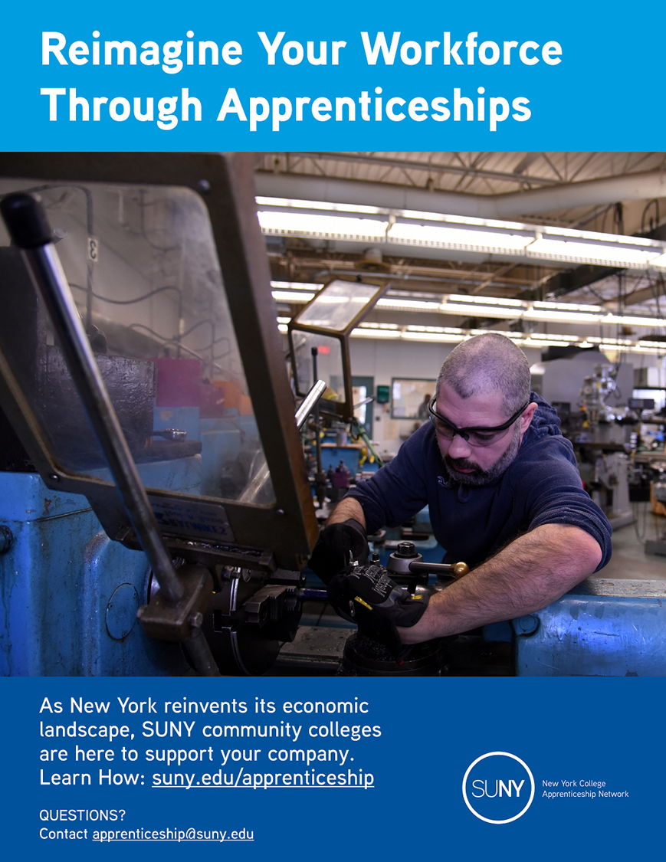
SUNY Apprenticeship Supports
1
Flexibility to build trainings based on employer need
Supports and referrals to retain students
Supportive: childcare, transportation
Academic: advising, tutoring
Subject matter experts with experience in the field
Pathways leading to SUNY credentials (Degrees, Certificates and Microcredentials)
2
3
4

Slide 8
Apprenticeship Pathways Across the System
OBTAIN:
EARN:
ACQUIRE:
Certificates
Microcredentials
Credits towards a degree
^{Direct Support Professional}
Fulton Montgomery Community College + Lexington ARC
^{CNC Machinist}
SUNY Ulster + LoDolce Machine Co.
^{Craft Brewing}
SUNY Schenectady + Frog Alley Brewing
Notes:
6 for class and 6 for OJT- SUNY SCCC
Certificate- Classes go beyond the RI (call or talk to FM)_

Slide 9
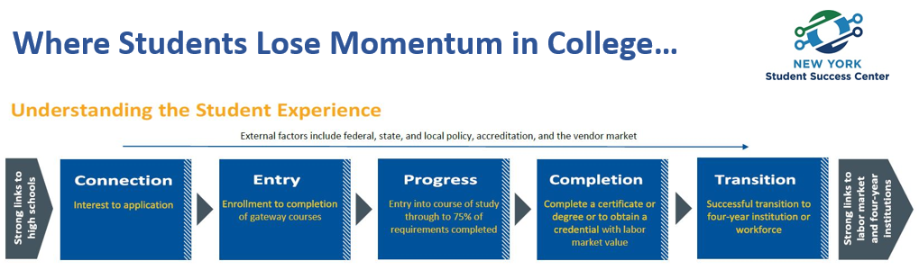
Source: Achieving the Dream/Completion by Design Loss Momentum Framework (https://www.achievingthedream.org/resource/15146/loss-momentum-framework-revised)
Notes:
Order is different – apprentices start with career (transition box) move to progress box. Need to bring back to connection/entry (before complete RI) – then to completion
Returning adult taking a few classes.
For apprentices need to demonstrate why they should continue past journeyworker card.
How do we convince employers there is a benefit? – have them realize if apprentice complete degree additional opportunity to move up within the company, retention and promotion

Slide 10

SUNY Apprenticeship Program
NYS annual $3.0 M budget line
  Advanced manufacturing
  Healthcare
  Other non-construction
NY College Apprenticeship Network
US DOL $7.9 M
  Advanced manufacturing

Slide 11
Role: SUNY System Administration
Coordinate with NYSDOL, lead partners & colleges
Manage and implement grant activities
Data collection and reporting
Support outreach efforts
Develop and conduct social media and marketing outreach statewide

Slide 12
Role: SUNY Institutions
Promote and conduct pre-apprentice training
Offer Related Instruction (RI)
  Work with employers to ensure relevancy
  Develop new RI
  Customize RI to meet needs of employer
Host Industry Roundtables
Conduct outreach to employers in their region
Develop and administer assessment for hybrid & competency-based programs

Slide 13
Benefits to SUNY
Increase enrollment
Pipeline non-credit to credit
Opportunity to develop new courses/programs
Courses for Related Instruction bundled into microcredentials
Mechanism to respond to regional business need
Enhance employer connections
Notes:
Microcredentials are short, focused credentials designed to provide in-demand skills, know-how and experience. Generally 3 – 4 courses combined
Community Colleges need to have flexibility in scheduling courses around apprentice’s work schedules

Slide 14
Funding Availability
Industry Roundtables (in-person or virtual): Up to $2,000 per in-person roundtable
---------------------------------------------------------------------------------------------------------------------------------------------------
Pre-apprenticeship: Up to $1,000 per pre-apprentice
---------------------------------------------------------------------------------------------------------------------------------------------------
Related Instruction (RI): Up to $5,000 per apprentice
---------------------------------------------------------------------------------------------------------------------------------------------------
Curriculum Development: Commensurate with college policy, cap of $3,500
for a new course and $1,750 for course revision
---------------------------------------------------------------------------------------------------------------------------------------------------
Hybrid & Competency-Based Assessment Determined on case-by-case basis
Tool Development & Administration:
---------------------------------------------------------------------------------------------------------------------------------------------------
Program Management (all projects are eligible): Up to 10% of the total cost of the projected project
Notes:
If don’t use full $5,000 for RI can be used toward additional coursework toward certificate or degree

Slide 15
Apprenticeship Titles Funded
Autobody Repairer and Painter
Brewer/Distiller
Business Operations Associate
Childcare Assistant
CNC Tool and Cutter Grinder
Community Health Worker
Computer Support Technician
Dairy Specialist
Data Analyst
Direct Support Professional
Drafter (Structural)
Electro-Mechanical Technician
Electronics Mechanic (CNC Systems Maintenance)
Electronics Technician
Fiber Optic Calibration Technician
Industrial Machinery Mechanic
Industrial Manufacturing Technician
Junior Accountant
Machine Builder
Machine Repairer
Machinist
Machinist (CNC)
Maintenance Mechanic
Maintenance Mechanic (Automatic Equipment)
Manufacturing Engineering Technician
Metal Refinisher
Model Maker
Mold Maker
Photonics Technician
Plant Maintenance Electrician
Plant Maintenance Mechanic
Plant Maintenance Millwright
Plumber and Pipefitter
Precision Optics Manufacturing Technician
Project Manager
Quality Assurance Auditor
Sales Associate
Screw Machine Set-Up & Operator
Software Developer
Teacher
Tool & Die Maker
Toolmaker
Truck Driver, Heavy
Wastewater Systems Operations Specialist
Welder
Notes:
Should highlight on this slide that other titles can be funded and new titles can be added.

Slide 16
SUNY System Apprenticeship Team
Denise Zieske, Director of Workforce Development
Office of Community Colleges and the Education Pipeline
^{Denise.zieske@suny.edu}
Mary Kohan, Project Manager, NYCAN
^{Mary.kohan@suny.edu}
Jan Hennessy, Project Coordinator, NYCAN
^{Jan.hennessy@suny.edu}
apprenticeship@suny.edu www.suny.edu/apprenticeship

